Slide 1
BLOOMING BEACON

Slide 2
What is Blooming Beacon?
Blooming Beacon is a student community Aimed at social welfare. Our aim is to empower women and children. We work to channelize youth’s energy in the right direction. Blooming Beacon with its mottos aims at Social development.

Slide 3
Our VISION
A society with inspired youth, independent women, ever learning children and respect for senior citizens.

Slide 4
Our Team

Slide 5
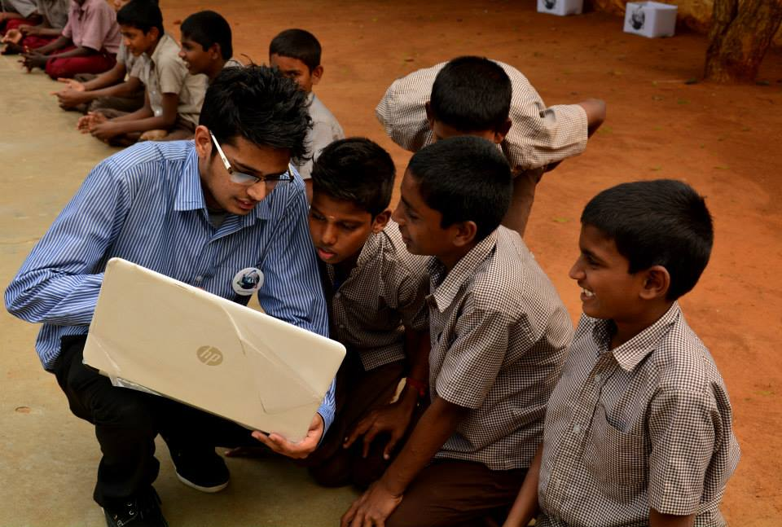
Youth for Social Welfare
Blooming Beacon being a Student group, we currently aim at Three things:
Women empowerment
Youth affairs
Overall Social development

Slide 6
How are we Planning to achieve this?
Blooming Beacon has registered as an NGO for the mentioned social cause.
Since its inception Blooming Beacon has been Conducting various events and activities for children and has been visiting several old age homes.

Slide 7
Blooming Beacon
Women empowerment
Youth affairs
Social affairs
Self protection
Stand for rights(equality)
Self employment
Awareness
Habits (time management)
Opportunities and directions
Orphans
Old age people
Needy

Slide 8
Glimpses of our Recent Events
Ganesh Chaturdhi Event
@Udhavam Ullangal illam,S.P Koil

Slide 9
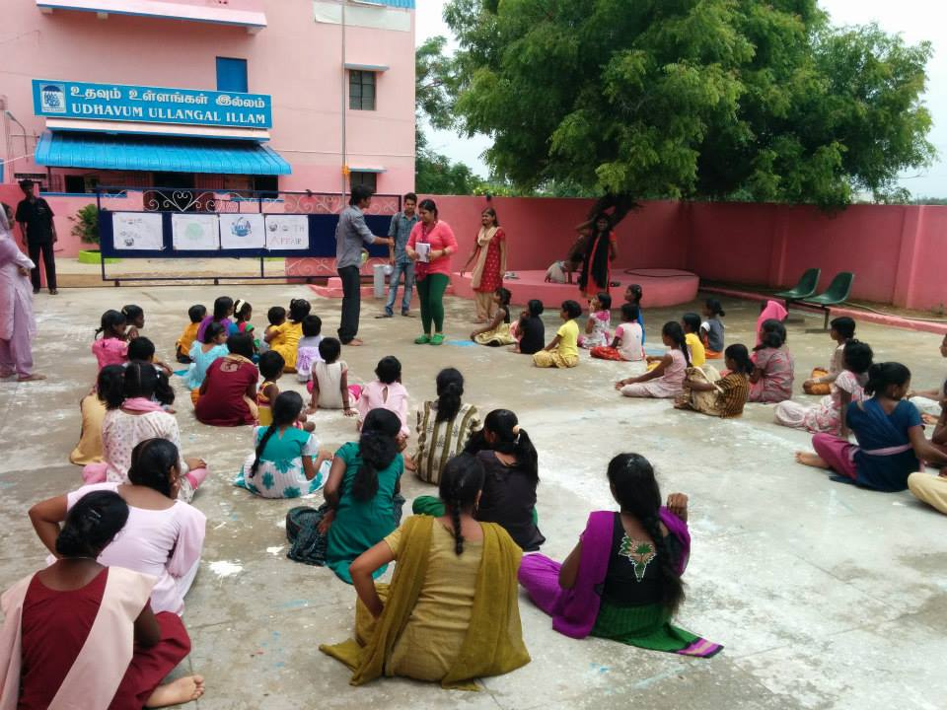
Activities for Children.
Involvement in activities is essential to rejuvenate one’s mind and senses.

Slide 10
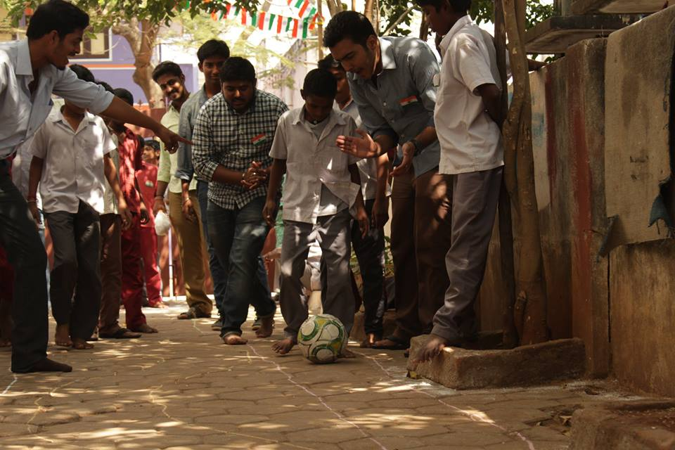
Our volunteers organizing an sport event to bring out competitive spirit of the children.
FOCUS!!

Slide 11
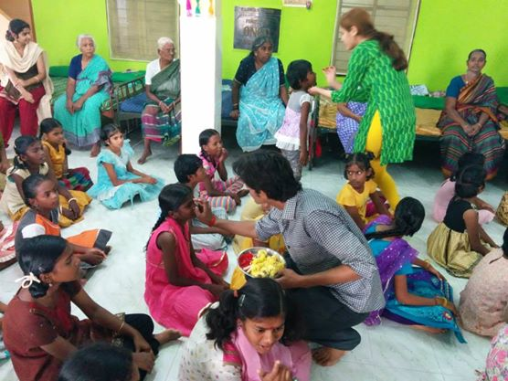
Our team interacting with the children to get a better insight in their life.
Everyone has their own idiosyncratic gestures !!

Slide 12
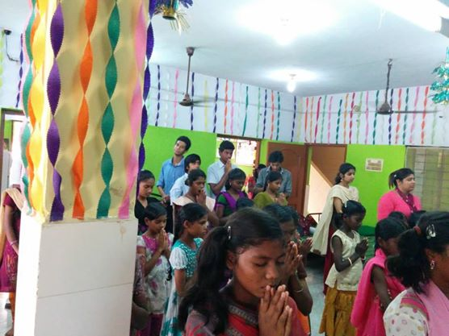
Teaching children the spiritual aspect of life.
Developing Concentration.

Slide 13
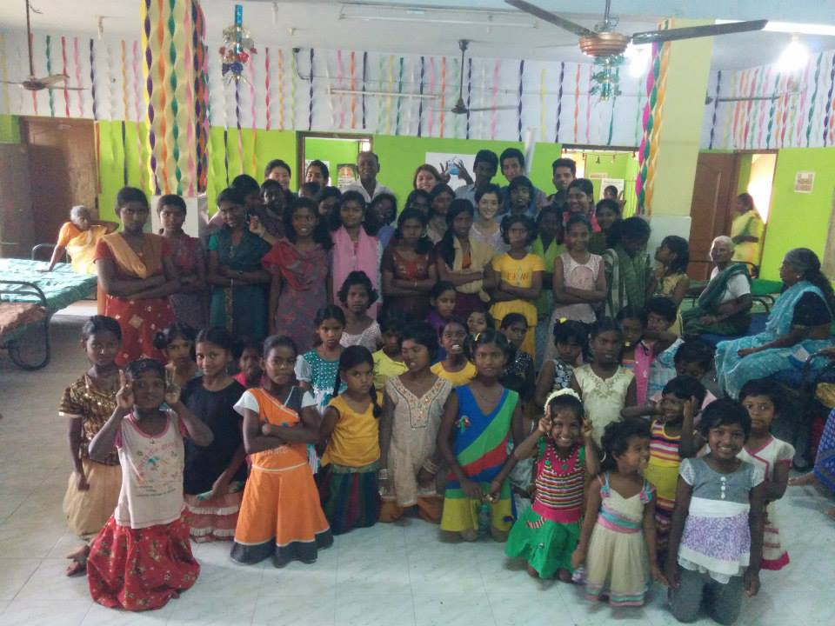
There cannot be a better feeling than leaving these children with a big smile on their face after a day full of educational and fun events.
Beatific Smile marks the character of Bonhomie.

Slide 14
Our Independence Day Event
@Good life center,
Tambaram

Slide 15
It is imperative that the best efforts and hardship should be viewed in high regards. One way to pay your homage is through the means of awards and rewards.
Cultural Programme
& Flag Hoisting

Slide 16
We understand our responsibility of spreading the sense of brotherhood in our younger generation. Here ,the children are taking the pledge to be a ‘Indian’ rising above all social segregation.
United we Stand;
Divided we fall.

Slide 17
“Under this flag, there is no difference between a prince and a peasant, between the rich and the poor, between man and women." -Sarojini Naidu Imparting this spirit to the children ,our team conducted the flag hosting ceremony
Proud to be an Indian.

Slide 18
Child care foundation, Tambaram
On 16th august just after independence day we conducted an awareness program in the ashram. We taught students about general food habits and daily routine.

Slide 19
Our members mentoring the children
It is very important that children take care of their personal hygiene. This is what we are trying to teach them here.

Slide 20
Well here we have a sparkling set of Teeth. Let’s promote them for others to have them too.
Because personal hygiene is important.

Slide 21
When wealth is lost, nothing is lost
When health is lost everything is lost
But when character is lost everything is lost.
As NGO we realize our responsibility to promote character building among the children.
Its etiquette and manners that constitutes one’s personality.

Slide 22
Event – v Sivananda ashram potheri
Again we come back to where it all started, This time we tried finding out the hidden talents of the children. we conducted an art competition , social awareness regarding general daily habits and a memorable handprint activity.

Slide 23
Everybody has an artist in them. We tried bringing it out!
Every artist was first an amateur.
Keeping that in mind we gave them a blank paper and asked them to bring out their imagination on the paper and as said that ‘artist himself is often surprised with the finished work of art’ ,those children could not tell ‘how it happened’, but there smiles were saying the whole story.

Slide 24
Well it is always the hand which leaves behind its imprints;
And it’s the eyes that can appreciate those prints.
For some of them its an art indeed;
Hand painting is the name that supersedes.
Bringing out the creativity

Slide 25
EVENT-IV Sivananda Ashram,Potheri
A four day event was conducted in the ashram by students of 1st, 2nd and 3rd year students which provided a complete package of computer learning skills to the students. The effort of the members was equally matched by the enthusiasm of the students.

Slide 26
There is no tool for development more effective than the empowerment of women as they form the backbone of the country.
Rightly said

Slide 27
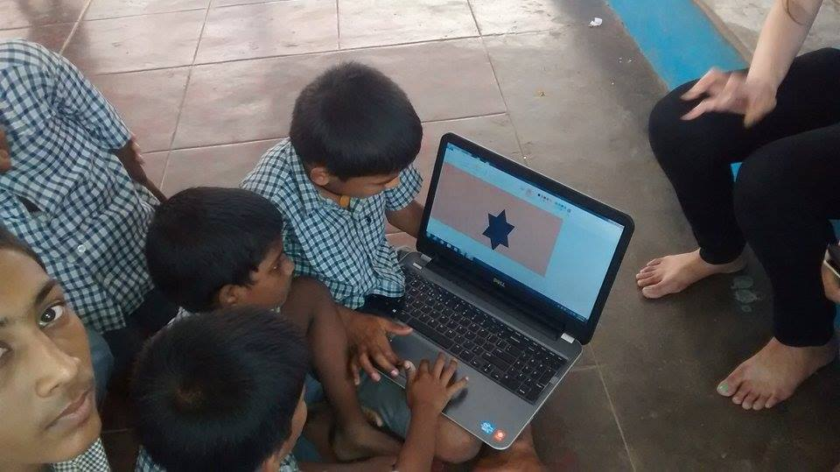
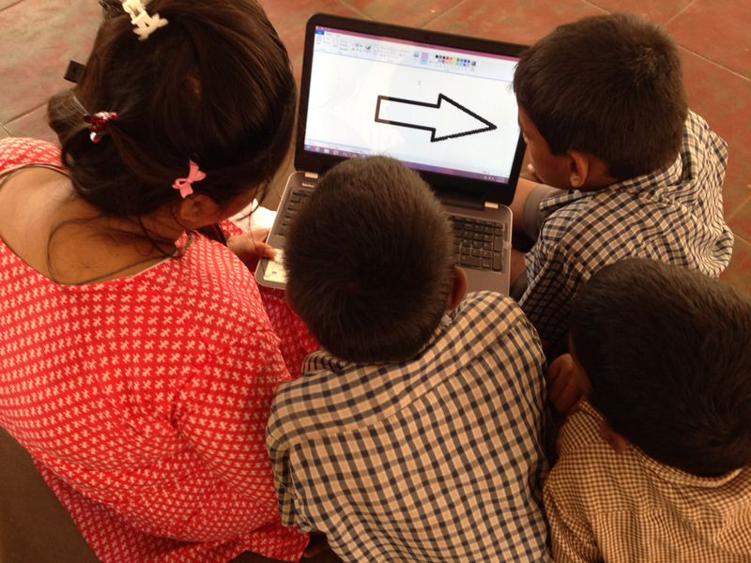
Its just not all about education , its also about the way of living.
Age of Technology is here!

Slide 28
EVENT-III Udhavam Illam, St. Thomas Mount
This time we moved onto teaching students. We taught them about Softwares like MS word ,Excel, Power Point, paint and how to use internet as well. All the members gave their best in teaching the students and finally the result was just overwhelming.

Slide 29
Children as they say are naturally curious. All that is needed to set their curiosity in the right direction. The learning automatically follows.
Curious to know more!!

Slide 30
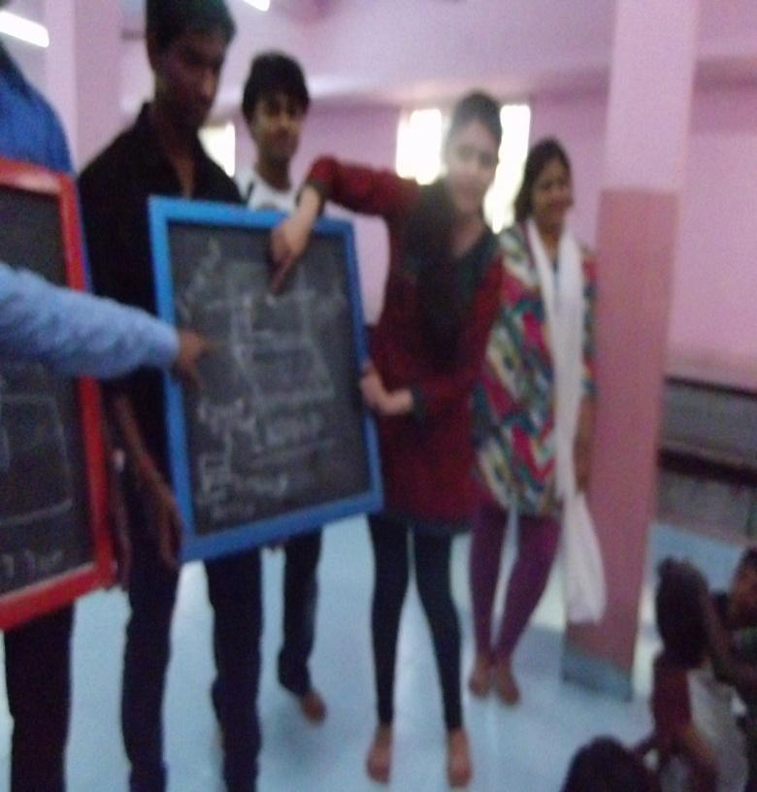
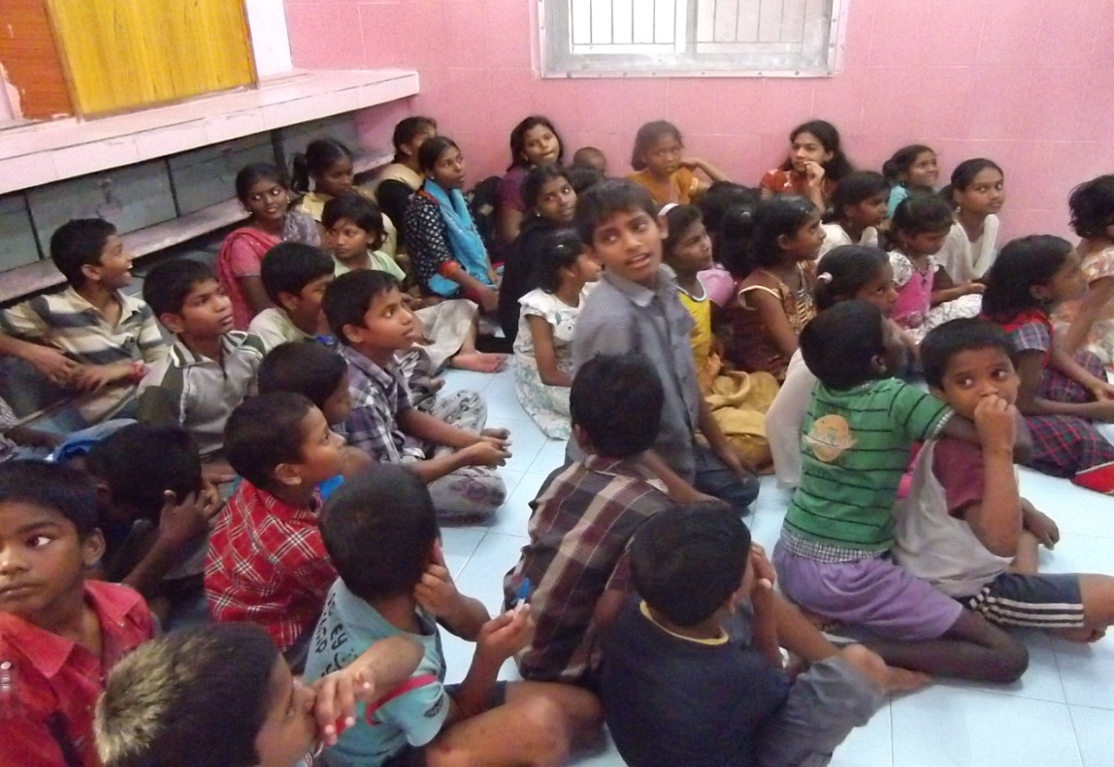
Education is sometimes a misunderstood concept. It is just not delivery of speeches and call it a day. It happens when it gets convoluted with learning.
Let us study together!!

Slide 31
EVENT-II Udhavam Ilam Ashram M.M.Nagar
After the first successful step we thought of spreading our activities to different areas. Here we taught students about different topics and hygienic habits through the medium of games. For students we provided stationary items and for old people we provided things of daily use. Again the event received a good feedback.

Slide 32
The eyes automatically suggests their inner desires. These inquisitive eyes tells us their desire of learning.
Building a educated society.

Slide 33
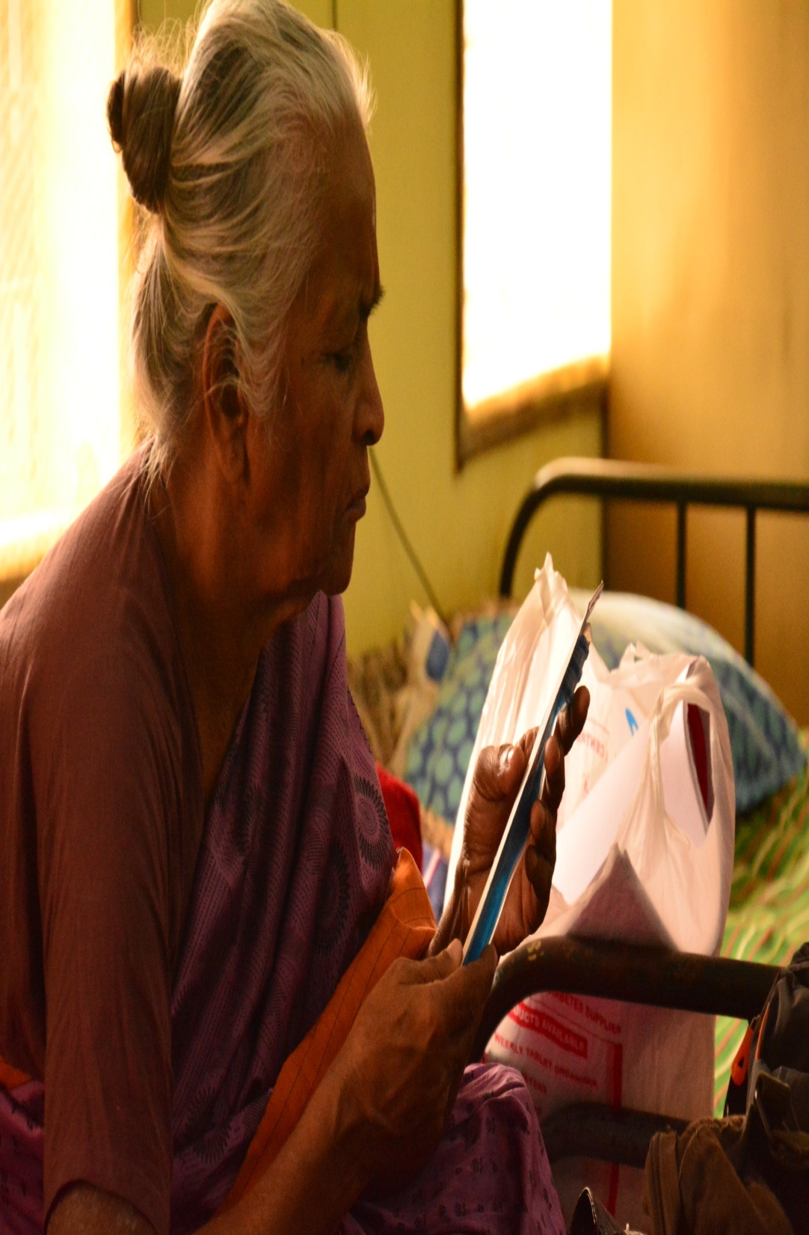
The enthusiasm and curiosity never dies, proving that age is just a number. We strive to bring these moments of excitement in their life .
Talent never ages!!

Slide 34
We went there to help them but got more in return, “their priceless blessings”.
It was a emotional day ,but we came back more determined to spread smiles and achieve our vision.
Benison is something truly cherubic.

Slide 35
They may seem shy in front of the camera but they are full of talent and enthusiasm , they are the future of our country.
They just need a platform to prove their talent , which our team “Blooming Beacon” intend to provide them.
Spreading the joy!

Slide 36
Event-I Sivananda Ashram,Potheri
A bunch of exciting and dedicated students taking their first step into social service together as Blooming Beacon. we focused on interacting with students over there. We conducted various knowledgeable activities.

Slide 37
We don’t intend to teach in the traditional way , as we believe having fun is an integral part of learning.
Breaking Stereotypes!!

Slide 38
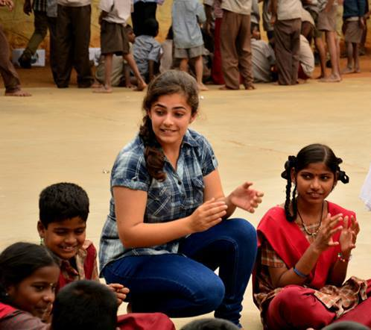
We believe that
“ Give until it gives you joy. When it does then you know that you are truly giving “
We feel that we are doing all this for ourselves such is the joy we get from spreading the smile on the faces of these children .
A million dollar smile

Slide 39
Being an NGO ,we understand our social responsibility of educating the children about traffic rules and regulations.
Here is our volunteer telling the children about the traffic symbols.
Imparting basic knowledge.

Slide 40
We strive to improve everyday and be better in terms of quality of education and knowledge that we share.
Keeping that in mind , our team did a survey among children after the completion of event ,to get there feedback for organizing a better event in the near future.
Introspection is essential.

Slide 41
How do we look at the Future?
With the same Spirit Blooming Beacon aims at organizing widespread awareness campaigns and other activities and aims to spread its cause effectively.

Slide 42
Resources?
Currently we have a team of over 50 people who actively participate in the events including the founder, secretary and people from other domains.
Financially, Blooming Beacon is more of a Self-run group. Monetary resources are pooled in by the group members.
We need your help to realize our vision of making our society an ideal one.

Slide 43
Contact us
www.bloomingbeacon.org
Facebook/bloomingbeacon
Mail at – bloomingbeacon.official@gmail.com

Slide 44
Help Appreciated!! (SPONSORS)
We would love to have the support you will offer
For being the sponsors of BLOOMING BEACON
Details-
State Bank of Hyderabad,
Guduvanchery, chennai 603202
CIF no.-72216309951
account no.-62408262066

Slide 45
We
Thank you

